Slide 1
Changing Police Culture A CIT Response To Crisis
Instructor Johnny Hollingsworth
Johnny.Hollingsworth@huntsvilleal.gov

Slide 2
GOALS
Define “Crisis Intervention Team (CIT)”
CIT History
CIT Goals
Police Response vs. CIT Model Response
More that training
Involving Community, Region & State

Slide 3
Problem Facing Policing
1 in 4 will suffer from a MI Crisis
Most have insight
One’s that don’t
One’s that don’t know they are ill
Families that don’t/no coping skills
Self-Medication
Wyatt vs Stickney 1972
Memphis TN 1987
Memphis NAMI
Lack of MI resources
Lack of soft skills training
The Bear in the Basement
Police Response
CIT Model Response
911 Triage

Slide 4
Bear In The Basement
Your normal is actually abnormal and borderline crises EVERYDAY

Slide 5
Let’s Get Deeper
That call, loved one wants to kill themselves & drinking
5:30pm on a Friday Evening
Call the Psychiatrist……..Answering machine
Call 911
Jail or ER………..ER first
Crisis Center
Detox
Back to Jail/ER

Slide 6
“The first goal of CIT programs is to transform the crisis response system to minimize the number of times that law enforcement officers are the first responders to individuals in emotional distress. If it’s a mental health crisis, there ought to be a mental health response. “
— Don Kamin, PhD, Director, Institute for Police, Mental Health and Community Collaboration, Rochester, New York

Slide 7
Changing Our Response To Crisis

Slide 8
Playing Into Their Delusion
Johnny’s Ghost

Slide 10
Better but issues
Serious MI accounts for 3-5% of violence
25% more risk to be a victim
Individuals with un-treated mental illness can be unpredictable
Safety
Searched Hand-cuffed
Back of a patrol unit
Then transported
Causes trauma

Slide 11
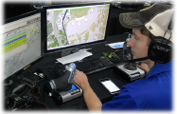
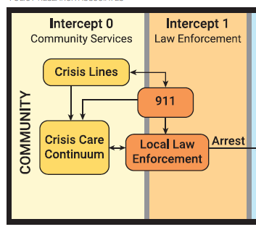
988 the new 911
911 Triage

Slide 13
Why except the cost?
Most crisis calls do not involve police
When un-safe, CIT officers
Hand-off to the Crisis Mobile Team
Most crisis resolved without transport
MH Professionals transport if needed

Slide 14
CIT PROGRAMS
More Than Training

Slide 15
CIT Core Elements
Ongoing Elements
Partnerships: Law Enforcement, Advocacy, Mental Health
Community Ownership: Planning, Implementation & Networking
Policies and Procedures
Operational Elements
CIT: Officer, Dispatcher, Coordinator
Curriculum: CIT Training
Mental Health Receiving Facility: Emergency Services
Sustaining Elements
Evaluation and Research
In-Service Training
Recognition and Honors
Outreach: Developing CIT in Other Communities
Dupont, R., Ph.D, Cochran, S., MS, & Pillsbury, S., MA. (2007, September). Crisis Intervention Team Core Elements. Retrieved March 11, 2019, from http://cit.memphis.edu/pdf/CoreElements.pdf

Slide 16
Crisis Intervention Team (CIT) Programs: A Best Practice Guide for Transforming Community Responses to Mental Health Crises Copyright © 2019 CIT International

Slide 17
State CIT Standards
Red Flags:
Just Training
Omits LE/MH/NAMI
No Co-Trainers
Less than 40-Hours
No “Family & Peer” perspectives
For Profit
Crisis Intervention Team (CIT) Programs: A Best Practice Guide for Transforming Community Responses to Mental Health Crises Copyright © 2019 CIT International

Slide 18
CIT Steering Committee Stakeholders
Crisis Intervention Team (CIT) Programs: A Best Practice Guide for Transforming Community Responses to Mental Health Crises Copyright © 2019 CIT International

Slide 19
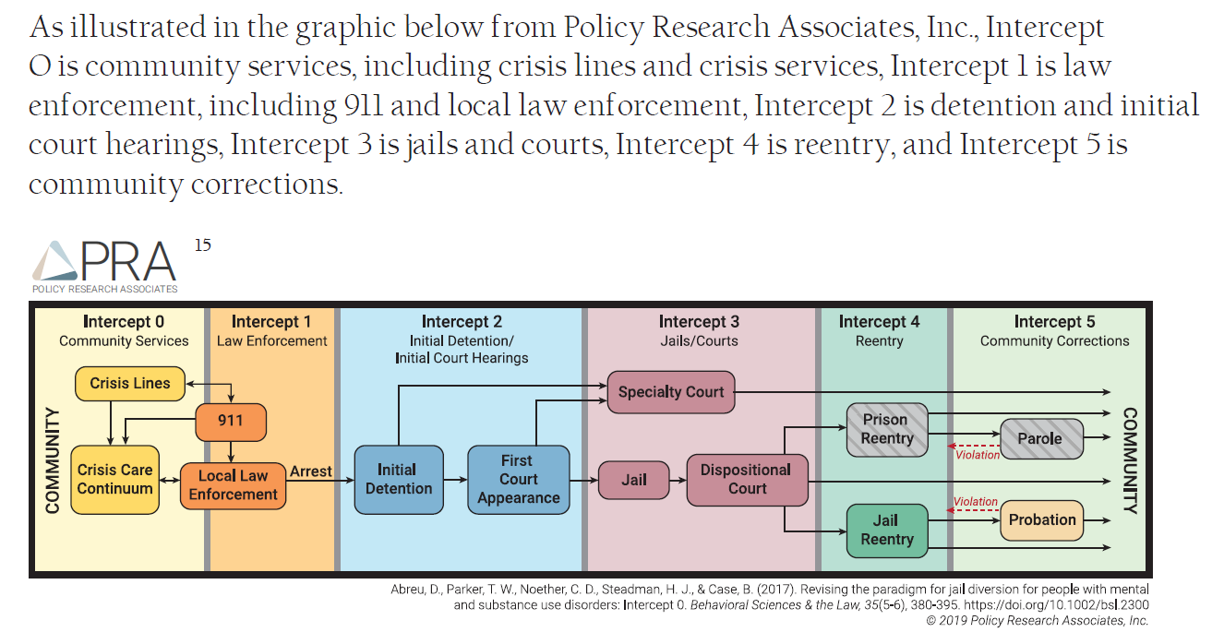
Sequential Mapping

Slide 20
Strategic Plan
CIT Model Response
Police Response
Steering Committee
Crises center
CIT Officers
Co-responders
Peer Specialists
Mobile Response
911 Triage
Local CIT Programs
Regional CIT Programs
State CIT Program
The Destination
The Starting Point
The Journey
The Checkpoints

Slide 21
BREAK

Slide 22
CIT TRAINING
Why this structure
Why co-instructors
Training Matrix
Behaviors not diagnoses
Hands on Exercises
Empathy development

Slide 23
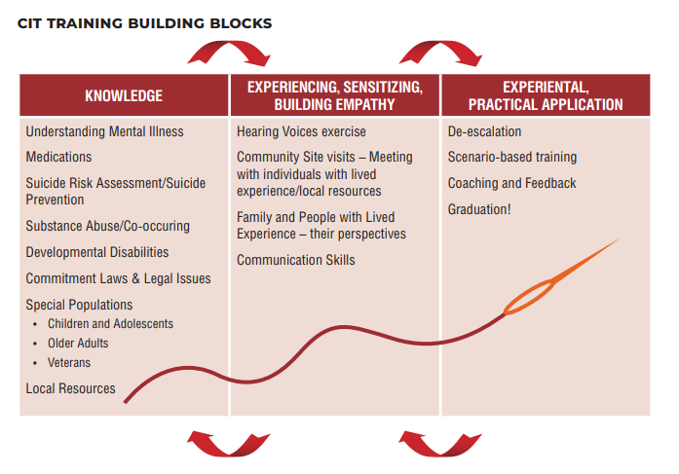
Crisis Intervention Team (CIT) Programs: A Best Practice Guide for Transforming Community Responses to Mental Health Crises Copyright © 2019 CIT International, PG. 125

Slide 24
Why Co-Instructors
Mental Health
Law Enforcement
Clinical lessons
Common Behaviors
Strategies based by behavior
Person First
It is an illness not a choice
Active listening skills
Tactical Lessons
Common Behaviors
Strategies based by behavior
Person First
It is an illness not a choice
Active listening skills

Slide 25
Crisis Intervention Team (CIT) Programs: A Best Practice Guide for Transforming Community Responses to Mental Health Crises Copyright © 2019 CIT International, pg 128.

Slide 26
We are providing discussions as well as experiences that will require you to leave your comfort zone

Slide 27
Behaviors
Major Depression (suicidal)
Bi-Polar (mania)
Borderline Anti-social
Schizophrenia (Delusions/hallucinations)
PTSD (anger/defensive)
Dementia
Relationship with emotions
Relationship with relationships
Relationship with reality
The Brain: (stops growing/grows to old)

Slide 28
Hands-On
Patriot
WORDS
Sensory Overload
Site Visits
Family & Peer panel
Scenarios

Slide 29
CIT DE-ESCALATION SKILLS
FBI Stairway to Behavioral Change
Body Language & Tone
Three types of distance
Once & Done
Specialized Trained Officers
Resources

Slide 30
The CIT Officer’s Role:
Influencing Behavioral Change
CHANGE
INFLUENCE
RAPPORT
EMPATHYY
ACTIVE LISTENING
Behavioral
Change Stairway
Active Listening is the foundation that supports everything else

Slide 31
70%
70% of people’s efforts to communicate about emotional issues are unheard, misunderstood or rejected.

Slide 32
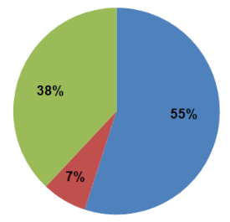
Mehrabian’s Rule
Albert Mehrabian established the importance of three elements in any face-to-face encounter:
Words Used (7%)
Tone of Voice (38%)
Body Language (55%)
There must be congruence among all three elements for effective communication

Slide 33
Once & Done
Listening skill are lost if not used
Training always should grow
Continuing Education must happened

Slide 34
State CIT Standards
CIT should be a volunteer/specialist
WHY????
Minneapolis, MN requires all officers to be certified in CIT!
Derek Chauvin was CIT Certified
Introduction to CIT & Mental Illness

Slide 35
WHY CIT INTERNATIONAL

Slide 36
QUESTIONS

